Slide 1


Boundless Lecture Slides
Available on the Boundless Teaching Platform
Free to share, print, make copies and changes. Get yours at www.boundless.com

Slide 2
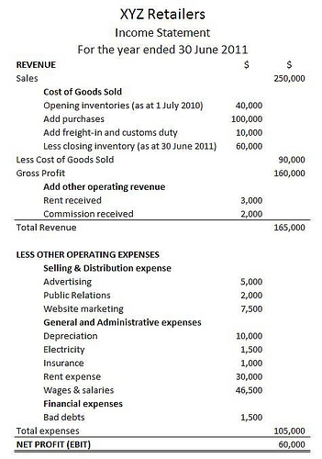

Standardizing Financial Statements
Analyzing Financial Statements > Standardizing Financial Statements
Income Statements
Balance Sheets
Free to share, print, make copies and changes. Get yours at www.boundless.com
www.boundless.com/accounting?campaign_content=book_378_section_97&campaign_term=Accounting&utm_campaign=powerpoint&utm_medium=direct&utm_source=boundless

Slide 3
Income Statements
Analyzing Financial Statements > Standardizing Financial Statements
Income statement displays the revenues recognized for a specific period, and the cost and expenses charged against these revenues, including write offs (e.g., depreciation and amortization of various assets) and taxes.
The income statement can be prepared in one of two methods: The Single Step income statement and Multi-Step income statement.
The income statement includes revenue, expenses, COGS, SG&A, depreciation, other revenues and expenses, finance costs, income tax expense, and net income.
Income statement
View on Boundless.com
Free to share, print, make copies and changes. Get yours at www.boundless.com
www.boundless.com/accounting/textbooks/boundless-accounting-textbook/analyzing-financial-statements-16/standardizing-financial-statements-97/income-statements-409-7079?campaign_content=book_378_section_97&campaign_term=Accounting&utm_campaign=powerpoint&utm_medium=direct&utm_source=boundless

Slide 4
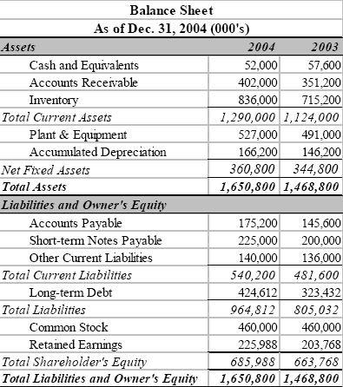
Balance Sheets
Analyzing Financial Statements > Standardizing Financial Statements
Of the four basic financial statements, the balance sheet is the only statement which applies to a single point in time of a business' calendar year.
The main categories of assets are usually listed first (in order of liquidity) and are followed by the liabilities.
The difference between the assets and the liabilities is known as "equity".
Balance sheets can either be in the report form or the account form.
A balance sheet is often presented alongside one for a different point in time (typically the previous year) for comparison.
Guidelines for balance sheets of public business entities are given by the International Accounting Standards Board and numerous country-specific organizations/companies.
Balance sheet
View on Boundless.com
Free to share, print, make copies and changes. Get yours at www.boundless.com
www.boundless.com/accounting/textbooks/boundless-accounting-textbook/analyzing-financial-statements-16/standardizing-financial-statements-97/balance-sheets-410-1870?campaign_content=book_378_section_97&campaign_term=Accounting&utm_campaign=powerpoint&utm_medium=direct&utm_source=boundless

Slide 5
Appendix
Free to share, print, make copies and changes. Get yours at www.boundless.com

Slide 6
Key terms
Analyzing Financial Statements
asset Something or someone of any value; any portion of one's property or effects so considered.
balance sheet A summary of a person's or organization's assets, liabilities and equity as of a specific date.
equity Ownership, especially in terms of net monetary value, of a business.
intangible asset Intangible assets are defined as identifiable non-monetary assets that cannot be seen, touched, or physically measured, and are created through time and effort, and are identifiable as a separate asset.
Free to share, print, make copies and changes. Get yours at www.boundless.com

Slide 7
Analyzing Financial Statements
Balance sheet
  Balance sheet shows financial position of a company.
Free to share, print, make copies and changes. Get yours at www.boundless.com
Google. "Google Image Result for." CC BY http://www.google.com/imgres?q=balance+sheet&hl=en&biw=1275&bih=639&tbs=sur:fmc&tbm=isch&imgrefurl=http://yell0brickrd.blogspot.com/2011/03/balance-sheets-made-simple.html&tbnid=3VggjTd1KcDiYM&docid=tmRLmlOWXYfy7M&ved=0CFIQhRYoAQ&ei=ctB9UNCELuSP0QGLr4DwBA&dur=4008 View on Boundless.com

Slide 8
Analyzing Financial Statements
Income statement
  GAAP and IRS accounting can differ.
Free to share, print, make copies and changes. Get yours at www.boundless.com
Flickr. "All sizes | y2cary3n6mng-5ha51l-income-statement-example | Flickr - Photo Sharing!." CC BY http://www.flickr.com/photos/sampjb/7690678408/sizes/m/in/photostream/ View on Boundless.com

Slide 9
Analyzing Financial Statements
Which of the following is a correct statement regarding a method of drafting a company's income statement?
A) The single-step method requires totaling a company's revenue, then subtracting all of its costs.
B) The multi-step method requires calculating the gross profit then subtracting operating expenses.
C) All of these answers.
D) The non-operating section of the multi-step method covers all non-primary revenues and losses.
Free to share, print, make copies and changes. Get yours at www.boundless.com

Slide 10
Analyzing Financial Statements
Which of the following is a correct statement regarding a method of drafting a company's income statement?
A) The single-step method requires totaling a company's revenue, then subtracting all of its costs.
B) The multi-step method requires calculating the gross profit then subtracting operating expenses.
C) All of these answers.
D) The non-operating section of the multi-step method covers all non-primary revenues and losses.
Free to share, print, make copies and changes. Get yours at www.boundless.com
Boundless - LO. "Boundless." CC BY-SA 3.0 http://www.boundless.com/

Slide 11
Analyzing Financial Statements
Which of the following statements regarding balance sheets is true?
A) A balance sheet covers a period of time.
B) Balance sheet account names and usage are up to the company producing the report.
C) The balance sheet's sections are assets, liabilities, and ownership equity.
D) All of these answers.
Free to share, print, make copies and changes. Get yours at www.boundless.com

Slide 12
Analyzing Financial Statements
Which of the following statements regarding balance sheets is true?
A) A balance sheet covers a period of time.
B) Balance sheet account names and usage are up to the company producing the report.
C) The balance sheet's sections are assets, liabilities, and ownership equity.
D) All of these answers.
Free to share, print, make copies and changes. Get yours at www.boundless.com
Boundless - LO. "Boundless." CC BY-SA 3.0 http://www.boundless.com/

Slide 13
Analyzing Financial Statements
According to the accounting equation, net worth must equal ________.
A) assets minus liabilities
B) liabilities minus assets
C) 50% of assets
D) 50% of liabilities
Free to share, print, make copies and changes. Get yours at www.boundless.com

Slide 14
Analyzing Financial Statements
According to the accounting equation, net worth must equal ________.
A) assets minus liabilities
B) liabilities minus assets
C) 50% of assets
D) 50% of liabilities
Free to share, print, make copies and changes. Get yours at www.boundless.com
Boundless - LO. "Boundless." CC BY-SA 3.0 http://www.boundless.com/

Slide 15
Analyzing Financial Statements
Which of the following is usually listed first on a balance sheet?
A) liabilities
B) ownership equity
C) assets
D) cash flow
Free to share, print, make copies and changes. Get yours at www.boundless.com

Slide 16
Analyzing Financial Statements
Which of the following is usually listed first on a balance sheet?
A) liabilities
B) ownership equity
C) assets
D) cash flow
Free to share, print, make copies and changes. Get yours at www.boundless.com
Boundless - LO. "Boundless." CC BY-SA 3.0 http://www.boundless.com/

Slide 17
Attribution
Analyzing Financial Statements
Wikipedia. "Balance sheet." CC BY-SA 3.0 http://en.wikipedia.org/wiki/Balance_sheet
Wiktionary. "asset." CC BY-SA 3.0 http://en.wiktionary.org/wiki/asset
Wiktionary. "equity." CC BY-SA 3.0 http://en.wiktionary.org/wiki/equity
Wiktionary. "balance sheet." CC BY-SA 3.0 http://en.wiktionary.org/wiki/balance+sheet
Wikipedia. "Income statement." CC BY-SA 3.0 http://en.wikipedia.org/wiki/Income_statement
Wiktionary. "intangible asset." CC BY-SA 3.0 http://en.wiktionary.org/wiki/intangible+asset
Free to share, print, make copies and changes. Get yours at www.boundless.com

