Slide 1


Boundless Lecture Slides
Available on the Boundless Teaching Platform
Free to share, print, make copies and changes. Get yours at www.boundless.com

Slide 2


Venture Capital
Obtaining Capital: Methods of Long-Term Financing > Venture Capital
Defining Venture Capital
Advantages and Disadvantages of VC Financing
IPOs
Free to share, print, make copies and changes. Get yours at www.boundless.com
www.boundless.com/finance?campaign_content=book_192_section_108&campaign_term=Finance&utm_campaign=powerpoint&utm_medium=direct&utm_source=boundless

Slide 3
Defining Venture Capital
Obtaining Capital: Methods of Long-Term Financing > Venture Capital
Venture capital is the financial capital provided to early-stage high-potential start-ups unable to acquire the necessary funding through conventional means.
For venture capitalists, the high risk of investing is offset by the potential of high returns.
Venture capitalists typically spread out their fund over a number of investments so that returns from successful investments will outweigh the losses from failed ventures.
Venture capitalists take an active role in a company's performance; guidance, expertise, and industry connections can be just as valuable as financial capital.
Venture capital funds revolutionary social networking services
View on Boundless.com
Free to share, print, make copies and changes. Get yours at www.boundless.com
www.boundless.com/finance/textbooks/boundless-finance-textbook/obtaining-capital-methods-of-long-term-financing-14/venture-capital-108/defining-venture-capital-459-7541?campaign_content=book_192_section_108&campaign_term=Finance&utm_campaign=powerpoint&utm_medium=direct&utm_source=boundless

Slide 4

Advantages and Disadvantages of VC Financing
Obtaining Capital: Methods of Long-Term Financing > Venture Capital
With VC financing, companies can acquire large sums of capital that would not be possible through bank loans or other conventional methods.
Venture capitalists provide expertise and industry connections that can be extremely valuable.
Accounting and legal costs make securing a VC deal a difficult process. If a deal is secured, VC investors will be highly involved in deciding on the company's strategic direction.
Weighing advantages and disadvantages
View on Boundless.com
Free to share, print, make copies and changes. Get yours at www.boundless.com
www.boundless.com/finance/textbooks/boundless-finance-textbook/obtaining-capital-methods-of-long-term-financing-14/venture-capital-108/advantages-and-disadvantages-of-vc-financing-460-5151?campaign_content=book_192_section_108&campaign_term=Finance&utm_campaign=powerpoint&utm_medium=direct&utm_source=boundless

Slide 5
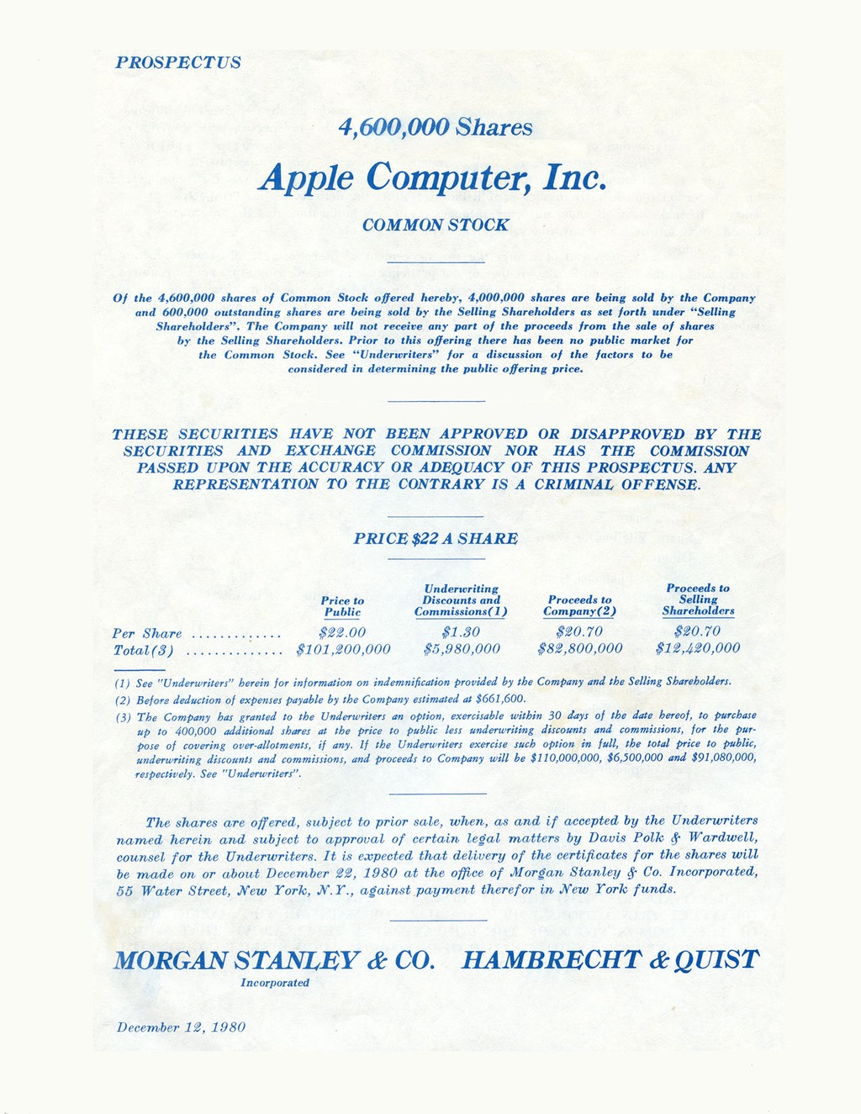
IPOs
Obtaining Capital: Methods of Long-Term Financing > Venture Capital
An initial public offering is the first time a company's stock is sold to the general public on a securities exchange, transforming the company from private to public. Though unpredictable and potentially costly, IPOs give benefits like increased access to financial markets and more capital.
Venture capitalists gain both financial returns and professional reputation from successful IPOs.
For venture-backed companies, their VC investors often expect the company to go public within a certain time frame so that they can sell or distribute their holdings of the company and exit the investment.
Venture capitalists protect their ability to sell shares by contracting for registration rights prior to agreeing on funding the company. Demand rights allow the investors to initiate an IPO, while piggyback rights allow investors to sell when the company initiates an IPO.
If the IPO market is weak, this threatens the venture capitalists' chances of a successful exit. The VC investors may instead select a different method of exit, or they can wait and hope for the market to improve.
Apple Computers IPO Prospectus
View on Boundless.com
Free to share, print, make copies and changes. Get yours at www.boundless.com
www.boundless.com/finance/textbooks/boundless-finance-textbook/obtaining-capital-methods-of-long-term-financing-14/venture-capital-108/ipos-461-8365?campaign_content=book_192_section_108&campaign_term=Finance&utm_campaign=powerpoint&utm_medium=direct&utm_source=boundless

Slide 6
Appendix
Free to share, print, make copies and changes. Get yours at www.boundless.com

Slide 7
Key terms
Obtaining Capital: Methods of Long-Term Financing
Initial public offering An initial public offering (IPO) or stock market launch is a type of public offering where shares of stock in a company are sold to the general public.
Initial public offering An initial public offering (IPO) or stock market launch is a type of public offering where shares of stock in a company are sold to the general public.
Registration rights A contractual agreement specifying conditions for registering shares of stock with the SEC prior to selling them on a security exchange.
venture capital Money invested in an innovative enterprise in which both the potential for profit and the risk of loss are considerable.
venture capital Money invested in an innovative enterprise in which both the potential for profit and the risk of loss are considerable.
Free to share, print, make copies and changes. Get yours at www.boundless.com

Slide 8
Obtaining Capital: Methods of Long-Term Financing
Venture capital funds revolutionary social networking services
  Facebook is one example of a entrepreneurial idea that benefited from venture capital financing. The Menlo Park-based firm has seen immense success since their launch in 2004. Unfortunately for Facebook's venture capitalist investors (Accel Partners, Greylock Partners and Meritech Capital), the IPO has not performed as well as expected.
Free to share, print, make copies and changes. Get yours at www.boundless.com
Wikimedia. "Wikimedia." CC BY-SA http://wikimedia.org View on Boundless.com

Slide 9
Obtaining Capital: Methods of Long-Term Financing
Weighing advantages and disadvantages
  Pursuing venture capital financing may not be appropriate for most start-up companies. It is important to weigh the benefits of receiving abundant resources against the costs of losing autonomy and ownership.
Free to share, print, make copies and changes. Get yours at www.boundless.com
Wikimedia. "Wikimedia Commons." CC BY-SA http://commons.wikimedia.org View on Boundless.com

Slide 10
Obtaining Capital: Methods of Long-Term Financing
Apple Computers IPO Prospectus
  The Initial Public Offering (IPO) Prospectus for Apple Computer Inc. in December 1980. A total of 5 million shares were offered to the public for $22 each. The total outstanding shares after the offering were 54,215,332. The company's officers, directors and major shareholders held 32 million shares and the rest were held by the company for stock options plans and other needs. Apple's valuation after the IPO was over $1 billion. (54 million shares at $22. )
Free to share, print, make copies and changes. Get yours at www.boundless.com
Wikimedia. "Wikimedia Commons." Public domain http://commons.wikimedia.org View on Boundless.com

Slide 11
Obtaining Capital: Methods of Long-Term Financing
Which of the following statements regarding venture capital is correct?
A) Venture capitalists are selective in their investments because each investment must turn a profit.
B) Most venture capital investments are done with pooled investment vehicles.
C) When a VC firm invests, they generally take a hands off approach regarding the firm's management.
D) All of these answers.
Free to share, print, make copies and changes. Get yours at www.boundless.com

Slide 12
Obtaining Capital: Methods of Long-Term Financing
Which of the following statements regarding venture capital is correct?
A) Venture capitalists are selective in their investments because each investment must turn a profit.
B) Most venture capital investments are done with pooled investment vehicles.
C) When a VC firm invests, they generally take a hands off approach regarding the firm's management.
D) All of these answers.
Free to share, print, make copies and changes. Get yours at www.boundless.com
Boundless - LO. "Boundless." CC BY-SA 3.0 http://www.boundless.com/

Slide 13
Obtaining Capital: Methods of Long-Term Financing
Which of the following is an advantage for a firm seeking VC financing?
A) The company retains autonomy.
B) VC funding offers companies an opportunity to expand that is not possible with other methods.
C) The accounting and legal fees associated with the funding are not shouldered by the firm.
D) All of these answers.
Free to share, print, make copies and changes. Get yours at www.boundless.com

Slide 14
Obtaining Capital: Methods of Long-Term Financing
Which of the following is an advantage for a firm seeking VC financing?
A) The company retains autonomy.
B) VC funding offers companies an opportunity to expand that is not possible with other methods.
C) The accounting and legal fees associated with the funding are not shouldered by the firm.
D) All of these answers.
Free to share, print, make copies and changes. Get yours at www.boundless.com
Boundless - LO. "Boundless." CC BY-SA 3.0 http://www.boundless.com/

Slide 15
Obtaining Capital: Methods of Long-Term Financing
Which of the following is NOT a benefit associated with a company initiating an Initial Public Offering (IPO)?
A) The company will be able to increase its exposure, prestige, and public image.
B) The company is guaranteed to raise additional capital necessary to expand its business.
C) The company will be able to attract and retain better management and employees.
D) The company will have cheaper access to capital.
Free to share, print, make copies and changes. Get yours at www.boundless.com

Slide 16
Obtaining Capital: Methods of Long-Term Financing
Which of the following is NOT a benefit associated with a company initiating an Initial Public Offering (IPO)?
A) The company will be able to increase its exposure, prestige, and public image.
B) The company is guaranteed to raise additional capital necessary to expand its business.
C) The company will be able to attract and retain better management and employees.
D) The company will have cheaper access to capital.
Free to share, print, make copies and changes. Get yours at www.boundless.com
Boundless - LO. "Boundless." CC BY-SA 3.0 http://www.boundless.com/

Slide 17
Attribution
Obtaining Capital: Methods of Long-Term Financing
Wikipedia. "Venture capital." CC BY-SA 3.0 http://en.wikipedia.org/wiki/Venture_capital
Wiktionary. "venture capital." CC BY-SA 3.0 http://en.wiktionary.org/wiki/venture+capital
Wikipedia. "Venture capital." CC BY-SA 3.0 http://en.wikipedia.org/wiki/Venture_capital
Wikipedia. "Venture capital." CC BY-SA 3.0 http://en.wikipedia.org/wiki/Venture_capital
Wikipedia. "Venture capital." CC BY-SA 3.0 http://en.wikipedia.org/wiki/Venture_capital
Wiktionary. "venture capital." CC BY-SA 3.0 http://en.wiktionary.org/wiki/venture+capital
Wikipedia. "Initial public offering." CC BY-SA 3.0 http://en.wikipedia.org/wiki/Initial%20public%20offering
Wikipedia. "Initial public offering." CC BY-SA 3.0 http://en.wikipedia.org/wiki/Initial_public_offering
Wikipedia. "Venture round." CC BY-SA 3.0 http://en.wikipedia.org/wiki/Venture_round
Boundless Learning. "Boundless." CC BY-SA 3.0 http://www.boundless.com//finance/definition/registration-rights
Wikipedia. "Initial public offering." CC BY-SA 3.0 http://en.wikipedia.org/wiki/Initial%20public%20offering
Free to share, print, make copies and changes. Get yours at www.boundless.com

